Slide 1
Visual Decoding with EEG
Isaac Van Benthuysen, Jack Caputo
SKIL IV - Final Presentation - 5/15/25
Notes:
Jack

Slide 2
TABLE OF CONTENTS
01
02
03
04
05
06
Background
Our Approach
Results
Discussion
Future Work
What We Learned
Notes:
Jack

Slide 3
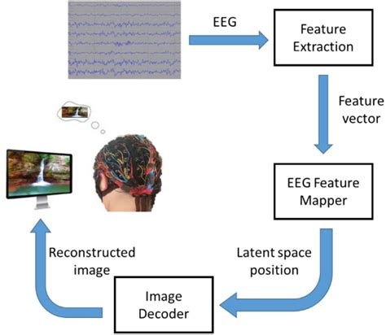
Motivation
Rise of ML/Deep Learning
Consider EEG data
Reaction to visual stimulus
Contains data of what was seen
Given EEG data, can we determine stimulus?
Go further: thinking of something creates stimulus
Implications:
“Communicate with your mind”
Those unable to speak/signal
Potential to analyze
https://www.biorxiv.org/content/10.1101/787101v3.full
Notes:
Jack

Slide 4
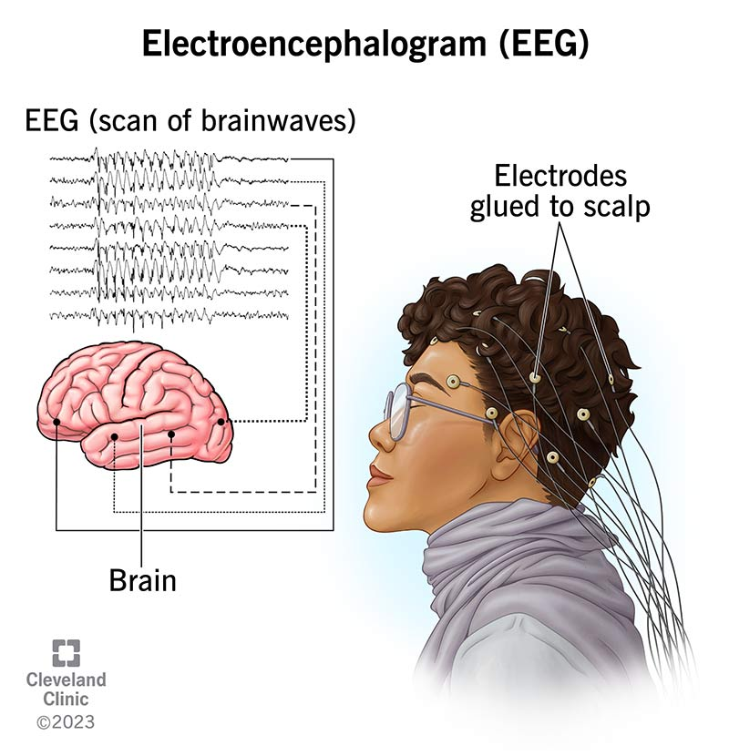
Background - EEG
Recording of electrical activity in brain
Neurons fire, generate action potentials
rapid depolarization and repolarization of cell, creates a mV pulse
Firing of individual neuron difficult to detect, but firing of many can be detected by electrodes on the scalp
Major limitation: low signal to noise ratio
Difficult to pick out meaningful data
ML can pick out meaningful patterns
Notes:
Isaac

Slide 5
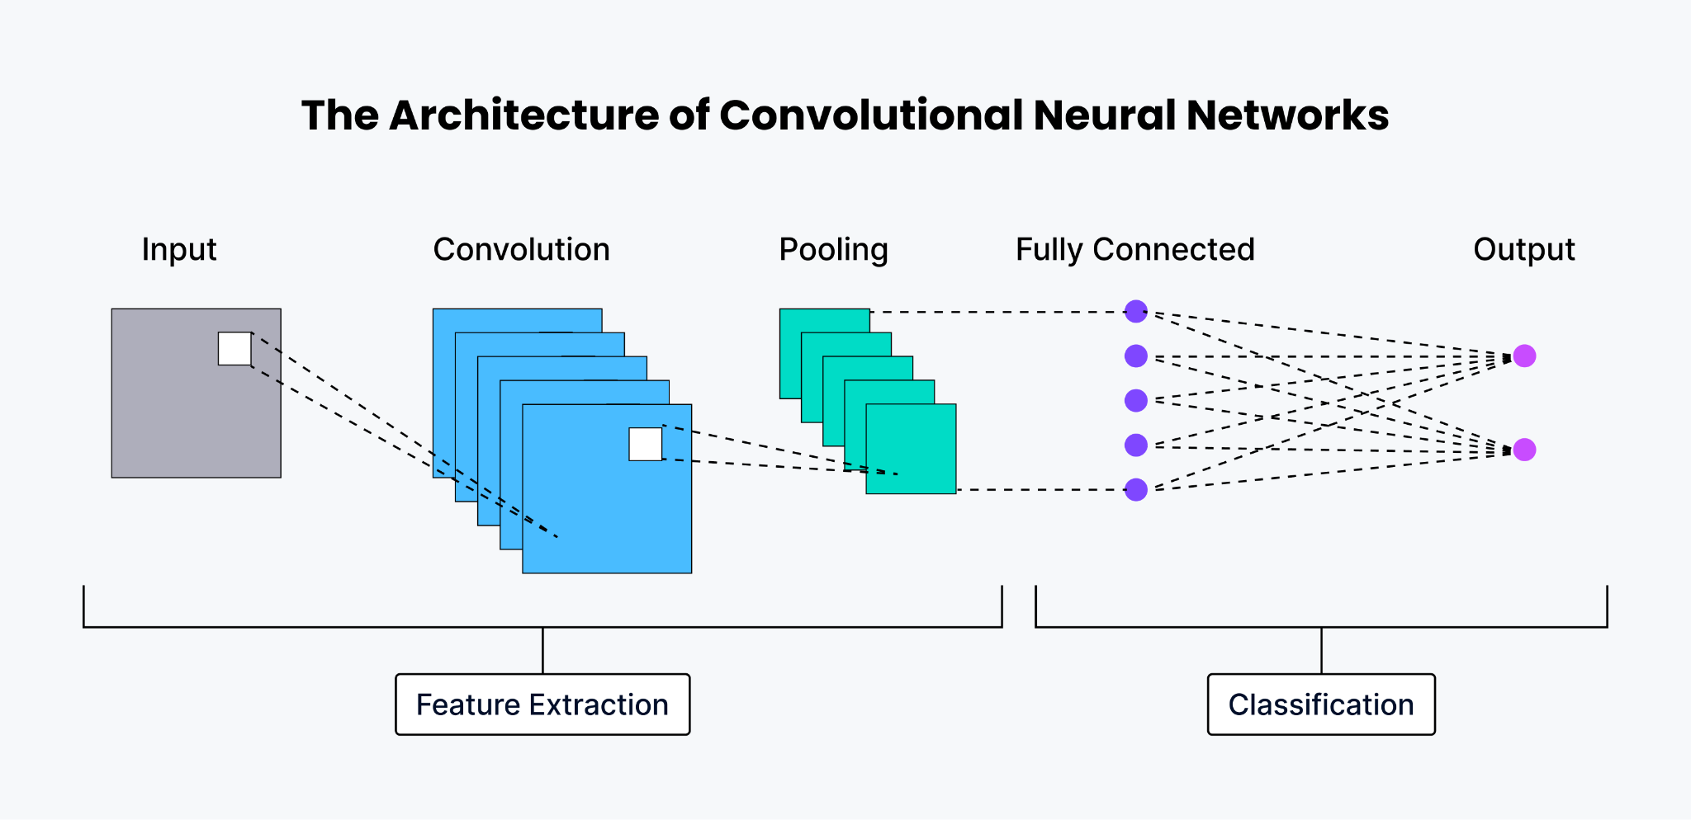
Background: COnvolutional Neural Networks
NNs based off neurons (input, hidden layers, outputs)
ex. of visual stimulus
CNNs use convolutions to create data model uses for predictions
Convolutions extract features
kernel slides over input
Pooling reduces dimensions
more room computationally for feature extraction
Flatten data
Dense layer to classifications
Backpropagation
minimize loss
Dropout
https://zilliz.com/glossary/convolutional-neural-network
Notes:
Jack

Slide 6

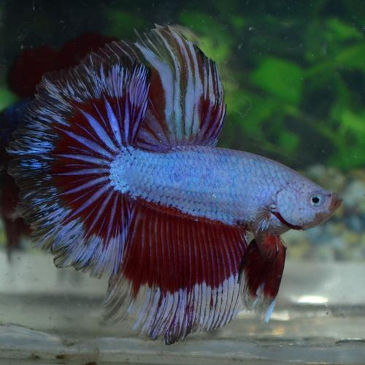
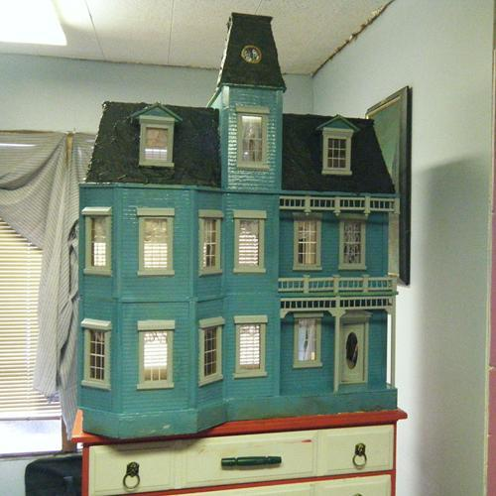
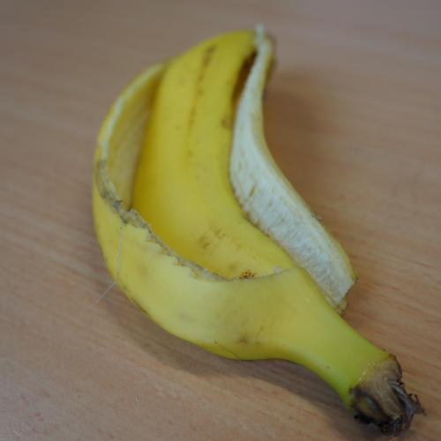
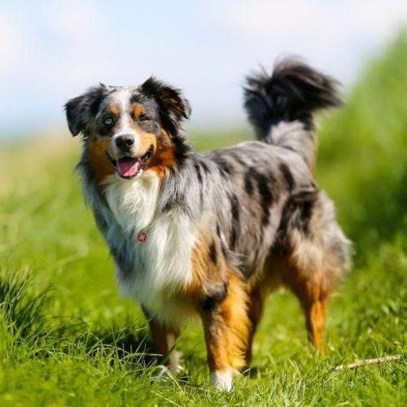

Our Approach - Data Preparation
Used THINGS EEG2 preprocessed data
Picked similar classes to paper we’re comparing to
Different classes tend to have different accuracies
75% training / 15% validation / 10% testing
1 repetition of each image goes to validation or testing (6 to validation, 4 to testing)
Split randomly to ensure each part has similar distributions of classes
But seeded to ensure repeatability
Normalized data
Shuffled order of samples
Notes:
Isaac

Slide 7
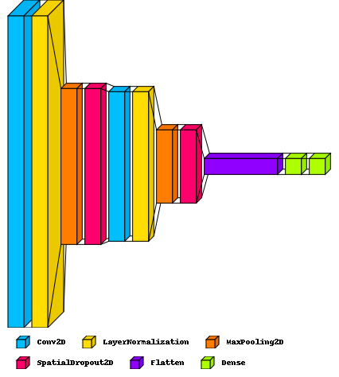
Our Approach: Model
Layer Type | Output Shape | # Parameters
Conv2D | (None, 15, 98, 16) | 160
LayerNormalization | (None, 15, 98, 16) | 32
MaxPooling2D | (None, 5, 49, 16) | 0
SpatialDropout2D | (None, 5, 49, 16) | 0
Conv2D | (None, 3, 47, 40) | 5800
LayerNormalization | (None, 3, 47, 40) | 80
MaxPooling2D | (None, 1, 23, 40) | 0
SpatialDropout2D | (None, 1, 23, 40) | 0
Flatten | (None, 920) | 0
Dense | (None, 128) | 117888
Dense | (None, 20) | 2580
Notes:
Isaac

Slide 8
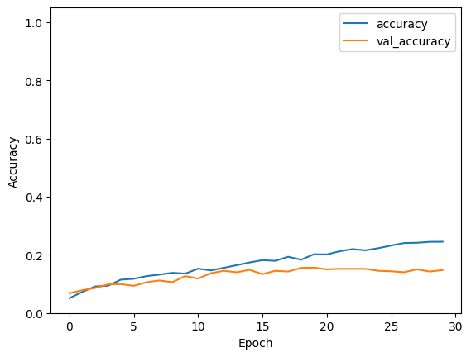
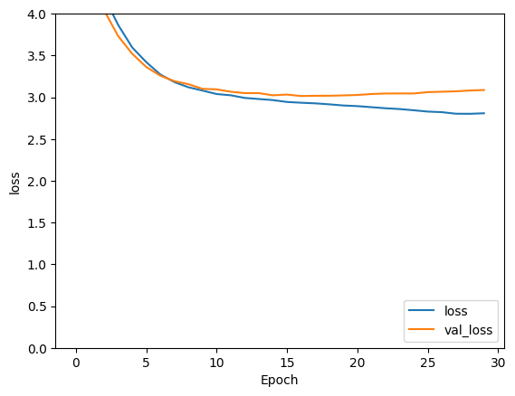
Results
Test Accuracy: 31.62%
Notes:
Isaac

Slide 9
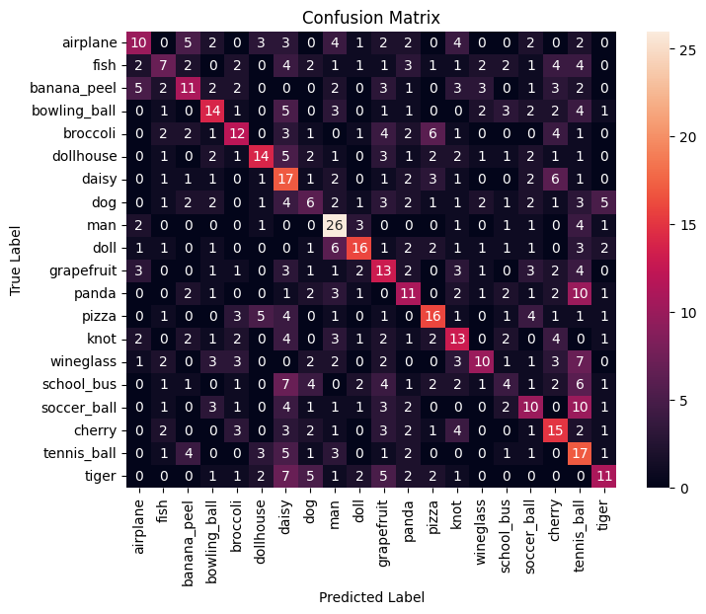
Notes:
Isaac
“Diagonally dominant” - Jack

Slide 10
Discussion: Comparison
EEGNet | 34.4%
Ours | 31.62%
TSception | 22.6%
EEG Conformer | 21.2%
EEG ChannelNet | 15.6%
EEG-to-Image | 6.4%
Random guessing | 5.0%
Notes:
Isaac

Slide 11
DIscussion: ML and Visual Decoding/Reconstruction
CNNs not correct method for EEG data classification
our highest accuracy ~32%
researchers’ highest accuracy ~34%
CNNs in varied applications; consistently >95%
CNNs for visual reconstruction not feasible
want to model scene
model must learn all objects
training is time consuming, computationally expensive, acc. goes down for more objects
Notes:
Jack

Slide 12
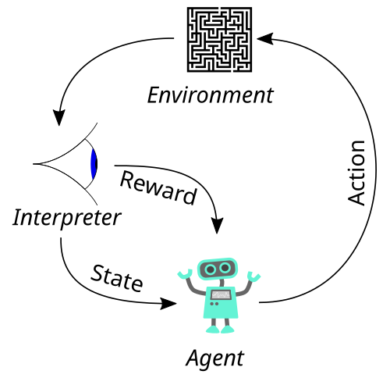
Future Work
CNNs don’t seem to be the way to go
Graph Neural Networks suggested
Reinforcement learning, unsupervised learning
Focus on decoding/reconstructing colors, textures, shapes
can construct image of any object from basic color and form, in theory
Other ideas in “Feasibility of decoding visual information from EEG”
https://en.wikipedia.org/wiki/Reinforcement_learning
Notes:
Isaac

Slide 13
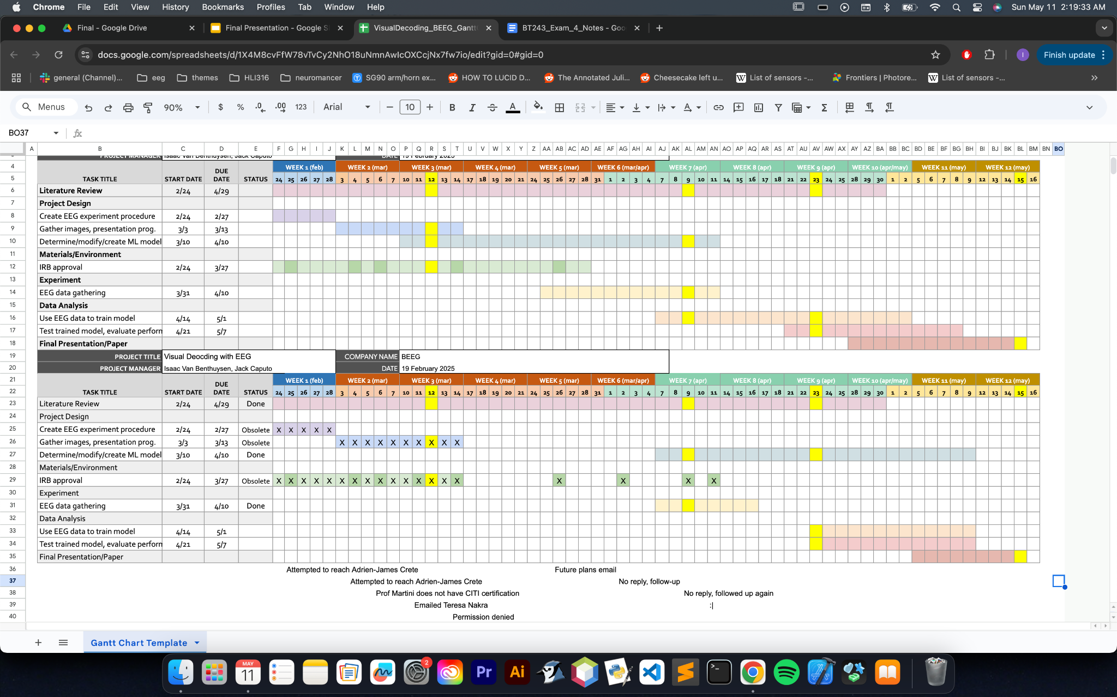
Planned:
Actual:
Notes:
Both

Slide 14
What We Learned: Project
Code
TensorFlow, Keras, Keras Tuner
Creating/training models in code
dealing with overfitting
Understanding and implementing layers to create a CNN
Preparing data for ML
How to have a good training/validation/testing distribution and split
How to work with huge tensors of data
Notes:
Both

Slide 15
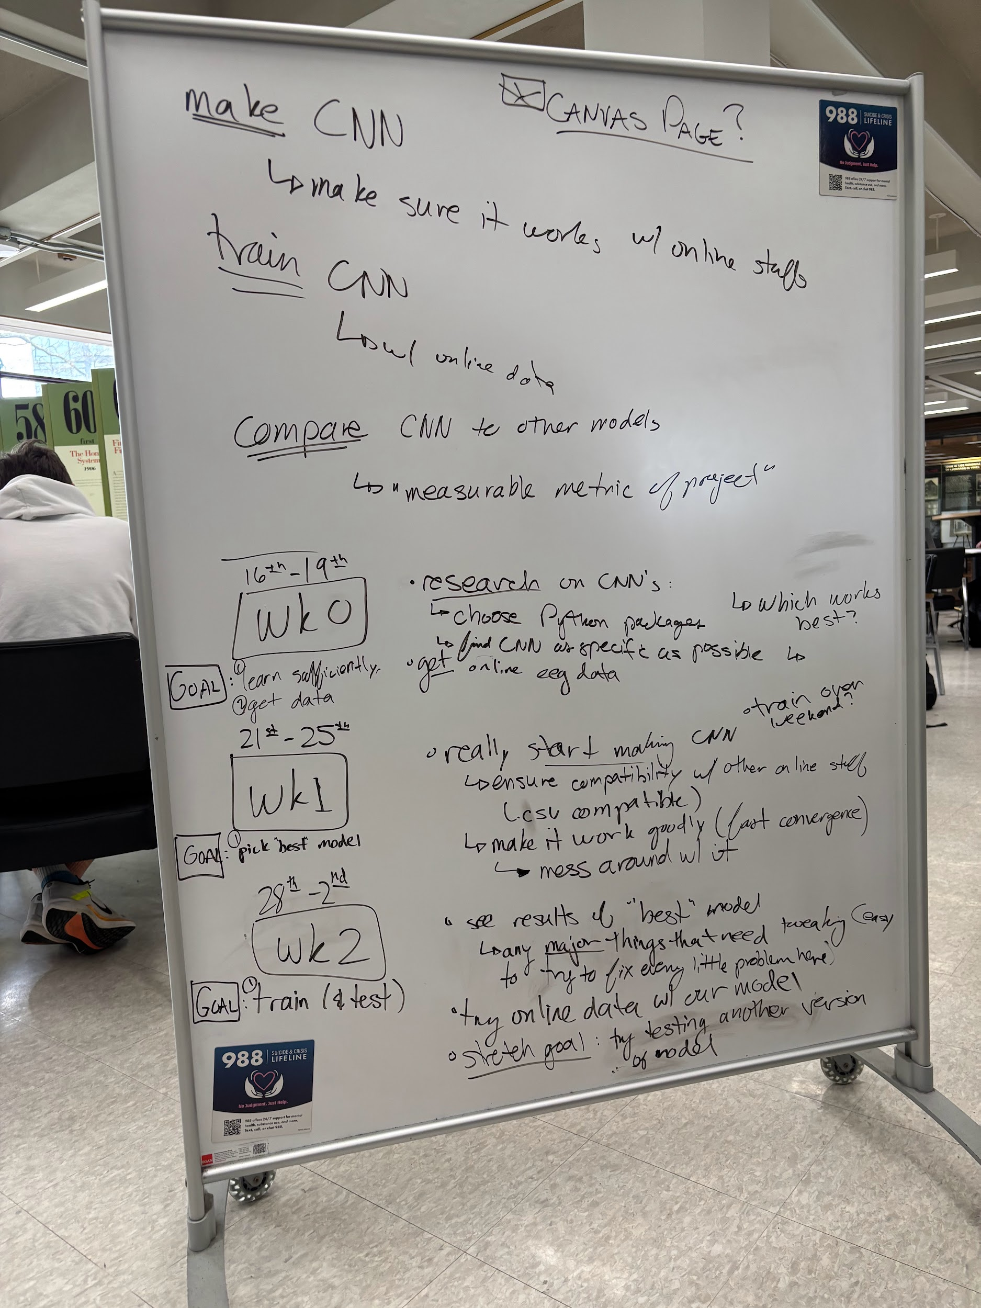
What We Learned: Administrative
Redefining our project
new, realistic goals/timeline
completed new goals
How to work effectively
weekly meetings
clear goals
division of labor
no excuses
Dealing with bureaucrats
Notes:
Both

Slide 16
Sources
Alessandro T. Gifford, Kshitij Dwivedi, Gemma Roig, Radoslaw M. Cichy. A large and rich EEG dataset for modeling human visual object recognition. NeuroImage, Volume 264, 119754 (2022). https://doi.org/10.1016/j.neuroimage.2022.119754.
Guenther, S., Kosmyna, N. & Maes, P. Image classification and reconstruction from low-density EEG. Sci Rep 14, 16436 (2024). https://doi.org/10.1038/s41598-024-66228-1
Wilson, H., Chen, X., Golbabaee, M., Proulx, M. J., & O’Neill, E. (2023). Feasibility of decoding visual information from EEG. Brain-Computer Interfaces, 11(1–2), 33–60. https://doi.org/10.1080/2326263X.2023.2287719

Slide 17
THANKS!
any questions?
Please keep this slide for attribution

